Slide 1

Architecture of Internet of Things

Slide 2
What is Internet of Things (IOT)
It is the networking of physical objects that contain electronics embedded within their architecture
This helps to communicate and sense interactions amongst each other or to the external environment.
They have a wide range of applications and is growing so fast.
Example:
Smart Watches
Speedometer
Voice assistant (Alexa, Siri, etc)

Slide 3
Architecture of IoT
Sensing Layer
Network Layer
Data processing Layer
Application Layer

Slide 4
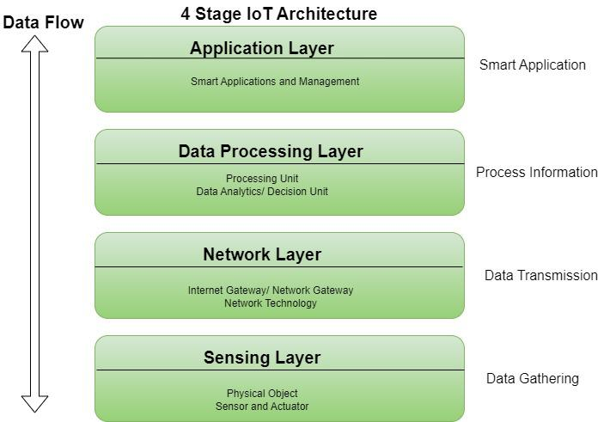

Slide 5
Sensing Layer
It is the first layer and is responsible for collecting data from different sources.
This layer includes sensors and actuators that are placed in the environment to gather information
Temperature, humidity, light, sound, and other physical parameters.
Wired or wireless communication protocols connect these devices to the network layer.
First layer
Sensors
Actuators

Slide 6
Network Layer
It responsible for providing communication and connectivity between devices in the IoT system.
It includes protocols and technologies that enable devices to connect and communicate with each other.
Examples are WiFi, Bluetooth, Zigbee, and cellular networks such as 4G and 5G technology.
WIFI
Gateways
Routers

Slide 7
Data processing Layer
It refers to the software and hardware components that are responsible for
Collecting,
Analyzing,
Interpreting data.
This layer is responsible for receiving raw data from the devices, processing it, and making it available for further analysis or action.
Collecting
Analyzing
Interpreting data

Slide 8
Application Layer
It is the topmost layer that interacts directly with the end-user.
It is responsible for providing user-friendly interfaces and functionalities that enable users to access and control IoT devices.
This layer includes various software and applications
mobile apps,
web portals, and
other user interfaces
Topmost layer
Data visualization
Users access and control

Slide 9
Advantages and Disadvantages of IoT
Advantages:
Execute multiple tasks at a time like a computer.
Easiest internet connectivity
Works on GUI (Graphical User Interface).
More reliable for software applications.
Disadvantages:
Security concerns and potential for hacking or data breaches.
Dependence on technology and potential for system failures.
Limited standardization among devices.
Complexity and increased maintenance requirements

Slide 10
Thank you
Alston Alvares​
Roll no: 01
Khushi Tiwari
Roll no: 09

